Slide 1
COMP1003 - Algorithms, Data Structures and Mathematics Lecture Searching and Sorting
Thomas Wennekers
Plymouth University

Slide 2
Main Ideas
Searching and Sorting are two sides of the same coin: sorted data can be searched quickly
Sorting algorithms roughly split into two classes:
“Comparative sorting” uses an order relation on entities and is theoretically bound to O(N log N)
“Integer sorting” uses properties of integers; it can be faster than comparison-sorting, but is more restricted (to integers and strings)

Slide 3
Why is this important ?
Much of computing deals with large amounts of data;
Often the data is linearly arranged and processed, e.g., in video or sound files ...
... more often the data consists of items that can be “randomly” accessed. Fast access times are often crucial.
Examples: file systems, data-bases, search engines

Slide 4
Aims and Objectives
review searching and sorting algorithms encountered so far
introduce the difference between “comparative sorting” and “integer sorting” using examples
explain the “divide and conquer” principles using quick-sort as an example

Slide 5
Outline
Search & Sort Algorithms encountered so far
Integer Sorting
counting sort, bucket sort, radix sort
Comparative Sorting
Divide and Conquer
quick sort, merge sort, heap sort

Slide 6
Review of Searching and Sorting Algorithms encountered so far

Slide 7
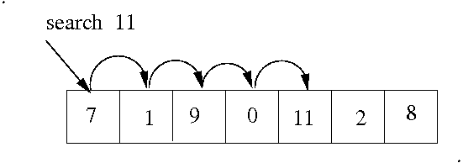
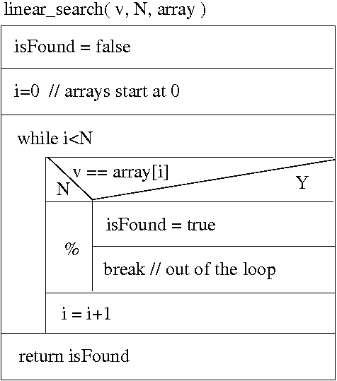
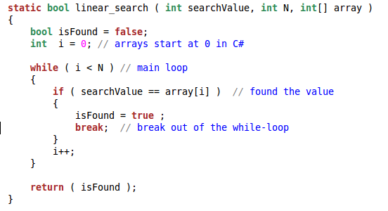
Linear Search (in Array or List)

Slide 8
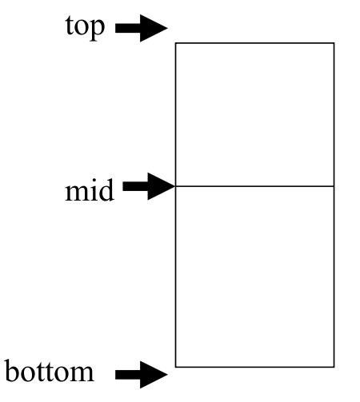
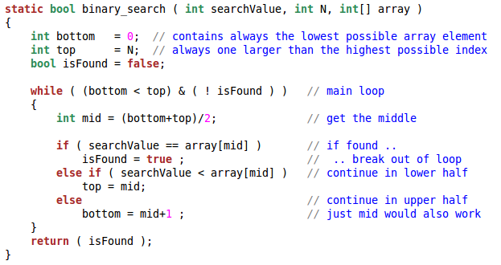
Binary Search in an Ordered Array

Slide 9
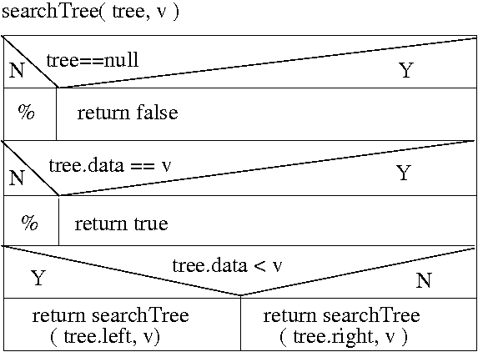
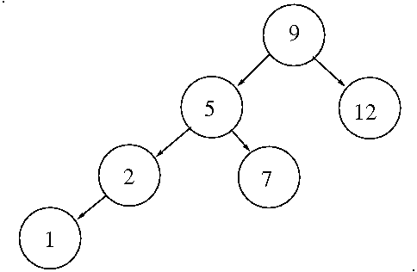
Binary Search Tree
Note the recursive function calls

Slide 10
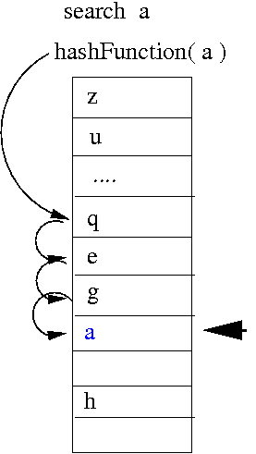
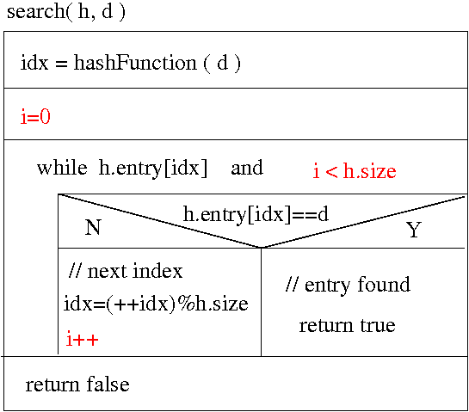
Search in a Hash Table

Slide 11
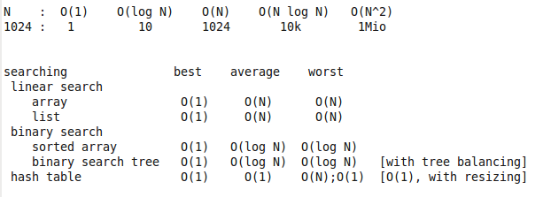
Searching Complexity of Algorithms seen

Slide 12
Sorting

Slide 13
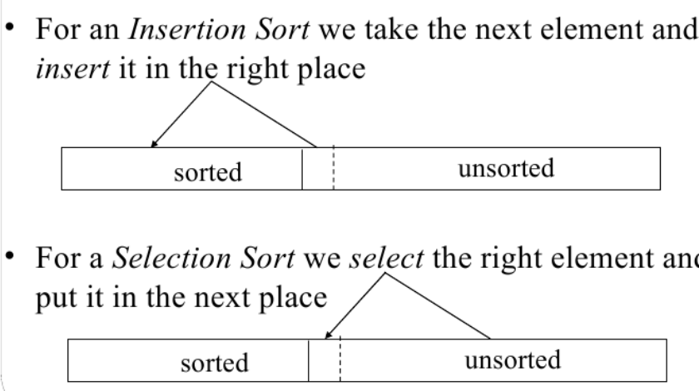
Selection and Insertion Sort

Slide 14
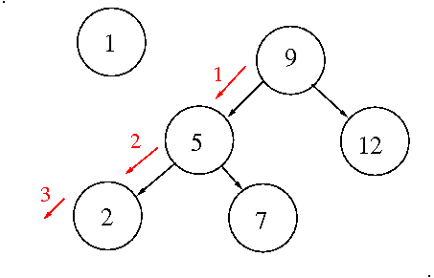
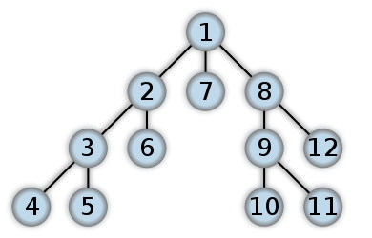
Binary Search Tree Insertion&Infix-Depth-First Traversal
Left: Insertion, right: depth-first traversal
Note: Numbers on the left are keys; numbers on the right order of node visit

Slide 15
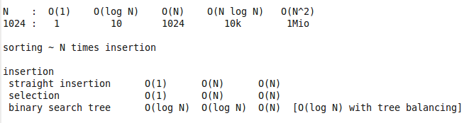
Sorting Review of Past Algorithms

Slide 16
More Sorting
Stable and in-place sorting
Integer versus Comparative Sorting
Divide-and-Conquer Principle

Slide 17
“Stable” Sorting
Complex Items can be sorted by keys
Different Items can have the same key
Stable Sorting keeps the order of items with the same keys
Example: Sort names by first Character
Input: Tom Frank Tina Tim Anna
Stable Sort: Anna Frank Tom Tina Tim
Not Stable: Anna Frank Tina Tim Tom

Slide 18
In-Place Sorting
Data occupies space in memory or on a drive
“In-place” sorting refers to a situation where a sorting algorithm does not need extra storage
Examples: Straight insertion and selection sort
Counter-example: Binary Search Tree
(because insertion is recursive and the tree has to be build)
Other algorithms use O(N) or O(log N) extra space but iteration (loops) and no recursion

Slide 19
Comparative versus Integer Sort Order Relations “<”
Keys satisfy a “total order relation” called “smaller than” (<) [or “bigger than” (>)]
A set of keys can be linearly arranged using the order relation
Examples:
the usual “<” on integers
lexico-graphic ordering on strings a < b; ba<bc
many other order relations exist → Maths

Slide 20
Comparative versus Integer Sorting
Comparative Sort makes explicit use of “<”
if x < y then ....
Integer Sort uses properties of numbers to sort
Notes:
Comparison sort is O(N logN) worst case
Integer sort has linear complexity but is restricted to numbers and strings

Slide 21
Integer Sorting

Slide 22
Counting Sort
Task: Given a large number of items with a relatively small number of integer keys (or chars or strings). Sort the items according to key order.
1) count how many items there are per key
2) allocate an array big enough to hold the data
3) Given the counts, set up an index table into the data array, indicating where the data of each key starts
4) Insert the items into the data array
Note: this does not use any comparisons between items

Slide 23
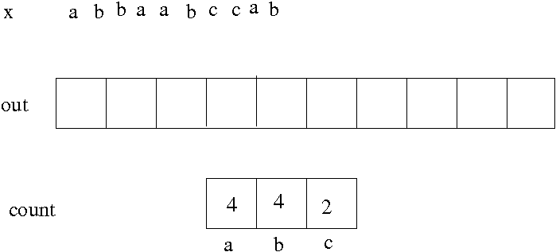
Counting Sort Example 1
Input x
Three keys: 'a' 'b' 'c'
Three counters: 4 4 2

Slide 24
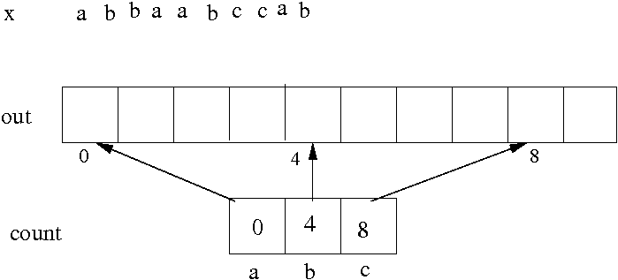
Counting Sort Example 2
Counters re-used as index into “out”

Slide 25
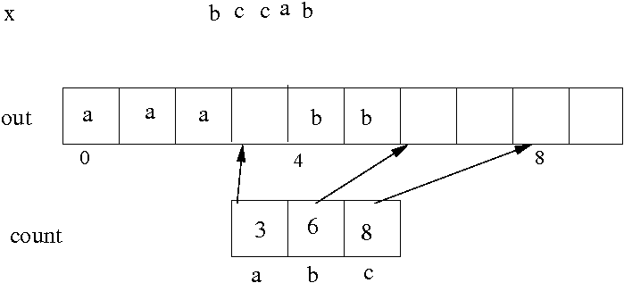
Counting Sort Example 3
After insertion of 5 elements
note the index updates

Slide 26
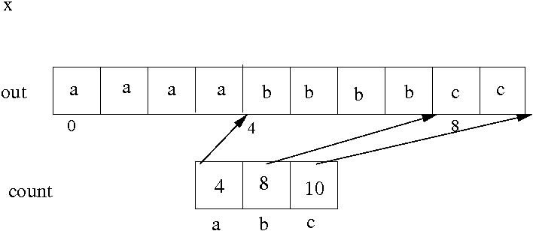
Counting Sort Example 4
Final situation; everything fits in

Slide 27
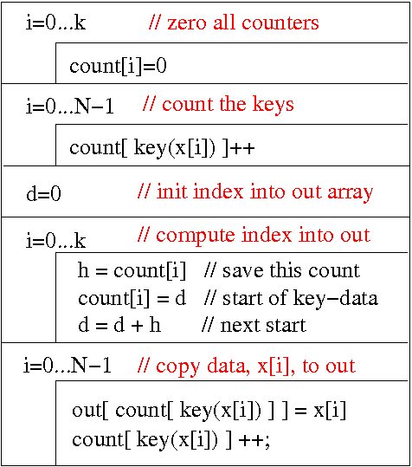
Counting Sort
input: x[N]
output: out[N]
uses keys 0..k
and k+1 counters

Slide 28
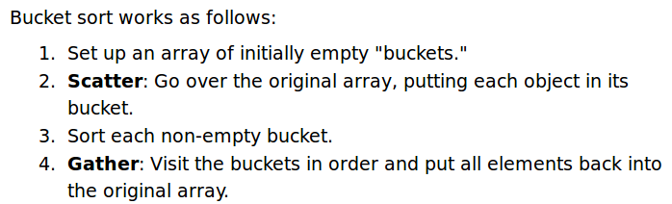
Bucket Sort
Similar to sorting of letters into a fixed number of boxes (or “buckets”)
Implementations use dynamic arrays or linked lists for the buckets; step 3 can use any sort algorithm

Slide 29
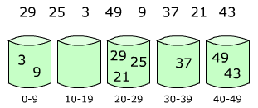
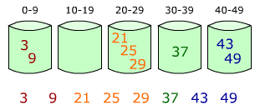
Bucket Sort
Input
Scatter
Gather
Output

Slide 30
Comparative Sorting

Slide 31
Comparative Sorting
Straight Insertion
Selection sort
Binary Search Tree
Bubble Sort (not covered, O(N^2); slow)
Quick Sort (O(N log N); “almost” in-place)
Merge Sort (O(N log N); quicker than quick-sort)
Heap Sort (not covered, O(N log N)&in place)
...more...

Slide 32
Divide-and-Conquer
Divide-and-Conquer is a programming strategy, where a problem of size N (e.g., sorting N numbers) can be recursively split into smaller problems (cf. binary search tree algorithms).
At some level the problem becomes easy, e.g., sorting one number is trivial
Partial solutions have to be recursively combined into the full solution
Recursive functions are often used to implement divide-and-conquer algorithms

Slide 33
Quick Sort
Quicksort first divides a large list (or array) into two smaller sub-lists (arrays): the “low elements” and the “high elements”. Quicksort then recursively sorts the sub-lists (or arrays).
1) pick an element (“pivot”)
2) re-order elements smaller than pivot to the left and larger elements to the right of pivot
3) sort the left and right arrays recursively

Slide 34
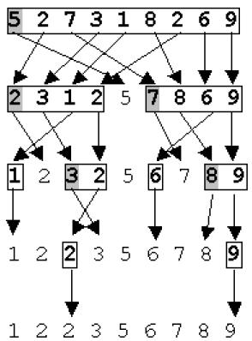
Quick Sort Example
This example takes the first element in each sub-array as the pivot
This is not the best strategy; because data may already be ordered; random choice may be better.

Slide 35
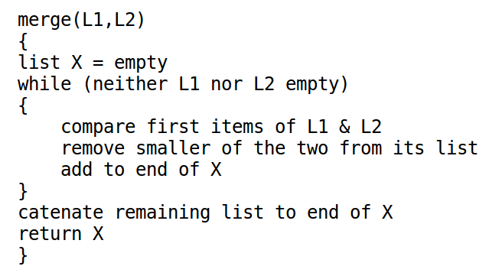
Merge Sort – The “Merge” Part
Assume we have two sorted lists of numbers
We can sort them into one list by iteratively taking the smallest element on top of either of the lists

Slide 36
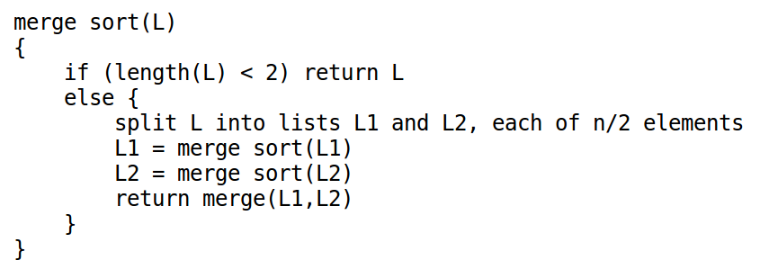
Merge Sort – The “Sort” Part
A one-element list is sorted; return it
A longer list can be split; the split parts can be sorted independently (recursively)
The sorted sub-lists can be merged to a longer list (to be returned to the next higher call)

Slide 37
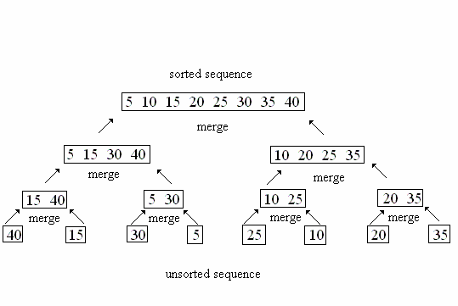
Merge Sort Example (Merging)

Slide 38
Notes – Quick & Merge Sort
A non-recursive solution for quick-sort exists that uses arrays “in-place”; there is, however, a small log(N) space overhead. The recursive solution hides this overhead in the recursive function calls. Time complexity is O(N log N) on average. Worst-case (in-frequent) of quick-sort is O(N^2); bad choice of pivot can cause this).
Merge sort uses typically less operations than quick-sort, but is also O(N log N) on average and int the worst case; most implementations use O(N) extra memory.

Slide 39
Outcomes
Overview of a number of sorting algorithms
Difference between “integer sorting” and “sorting by comparison” or “comparative sorting
The divide-and-conquer principle
The merge-sort and quick-sort algorithms

